Slide 1
HTML
INTRODUCTION TO HYPERTEXT MARKUP LANGUAGE (HTML)

Slide 2

INTERNET VS WORLD WIDE WEB (WEB)
Internet
Connects computer.
Network cable, and routers around the world
World Wide Web
Connects people to computer
Users URLs
Uses software to connect client to services/servers
Connecting Computers
Connecting People
Hardware
Software

Slide 3
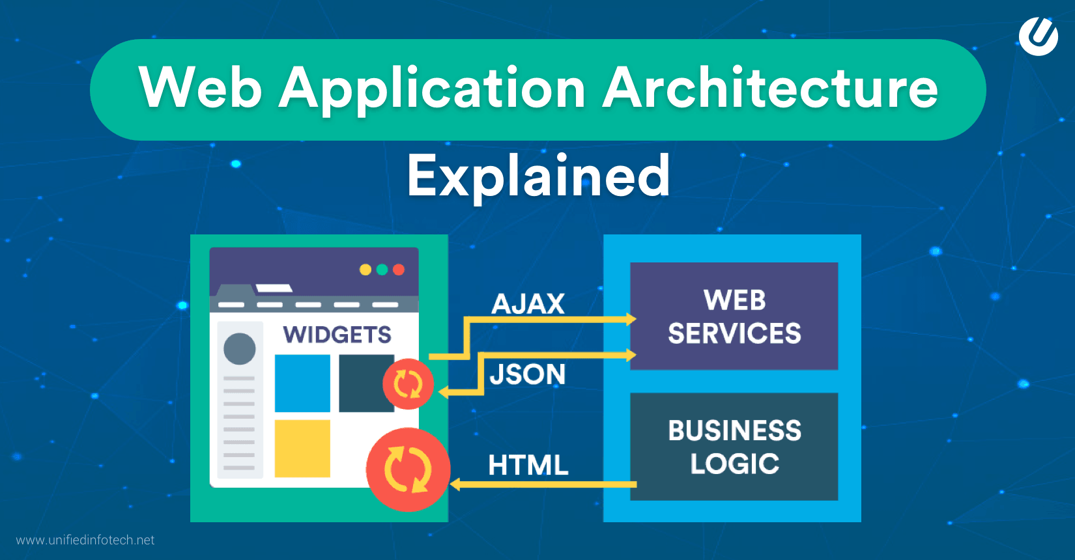
WEB DEVELOPMENT ARCHITECTURE – FULL STACK
JavaScript
HTML
CSS
Java
ASP.net/C#
JavaScript
SQL
PHP
SQL
JavaScript
JSON
DATABASE

Slide 4
WEB DEVELOPMENT ARCHITECTURE – FULL STACK
Frontend
User Interface
Allows Input of Data
Displays Data to user
Backend
Business Logic
Data Validation
Data Processing
Security Checks
Database
Read, Writes and Stores data
What we will be learning
HTML
CSS
Javascript
PHP
Javascript
MySql

Slide 5
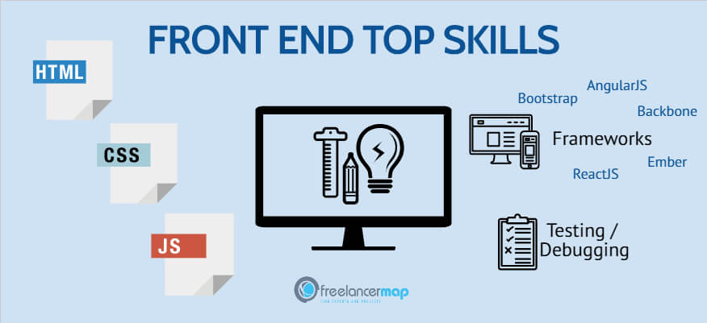

FRONT-END DEVELOPMENT

Slide 6
FRONT-END DEVELOPMENT
Front-end development is the development of the user interface. This includes data entry, displaying of information and all interactions with the user.
Web Front-end Development is made up of three languages that run in all browser.
HTML - Hyper Text Markup Language
Is the standard markup language for creating Web pages
Describes the structure of a Web page
Consists of elements that tells the browser how to display the content
CSS – Cascading Style Sheets
Style of webpage
Layout of the page
JavaScript
Allows you to implement complex features on web pages
Dynamically updates page content
Listens to events on from user interaction
Communicates with the backend
Brains of a webpage

Slide 7
WHAT IS HTML
HTML (Hypertext Markup Language) is the code that is used to structure a web page and its content. For example, content could be structured within a set of paragraphs, a list of bulleted points, or using images and data tables.
HyperText - Means text with links
Markup Language - A markup language is a computer language that uses tags to define elements within a document. It is human-readable, meaning markup files contain standard words, rather than typical programming syntax.
HTML is a markup language that defines the structure of your content. HTML consists of a series of elements, which you use to enclose, or wrap, different parts of the content to make it appear a certain way, or act a certain way. The enclosing tags can make a word or image hyperlink to somewhere else, can italicize words, can make the font bigger or smaller, and so on.

Slide 8
HISTORY OF HTML
1993 - The first browser Mosaic - HTML 1.0
1994 - Second browser Netscape, HTML 1.0
1995 - HTML 2.0
1997 - HTML 3
1999 - HTML 4.01 - the most common standard
2014 - HTML 5 - latest version
W3C Standardization
World Wide Web Consortium

Slide 9
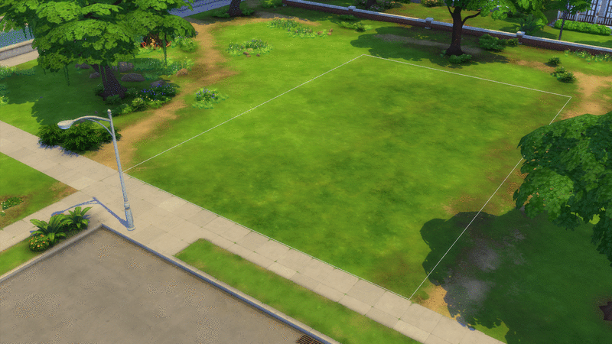
IMPORTANT ASPECTS OF WEB DEVELOPMENT
When building a house, we first lay the foundations, walls, roof, only then we take care of the colors, furniture and interior.
In some web pages, we also create its structure first and only then style.
Our HTML code will depend on
page design
page goal
target user groups
actions that the visitor should take

Slide 10

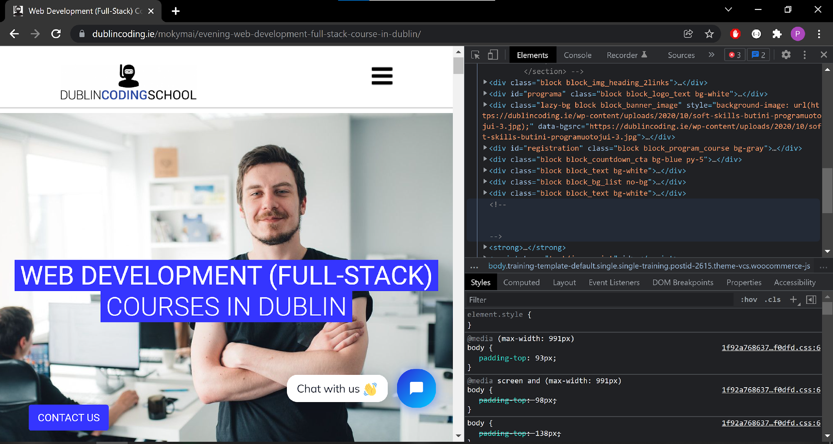

TOOLING
Chrome Dev tools
Online IDEs
https://jsbin.com/
https://codepen.io
https://jsfiddle.net
http://plnkr.co/

Slide 11
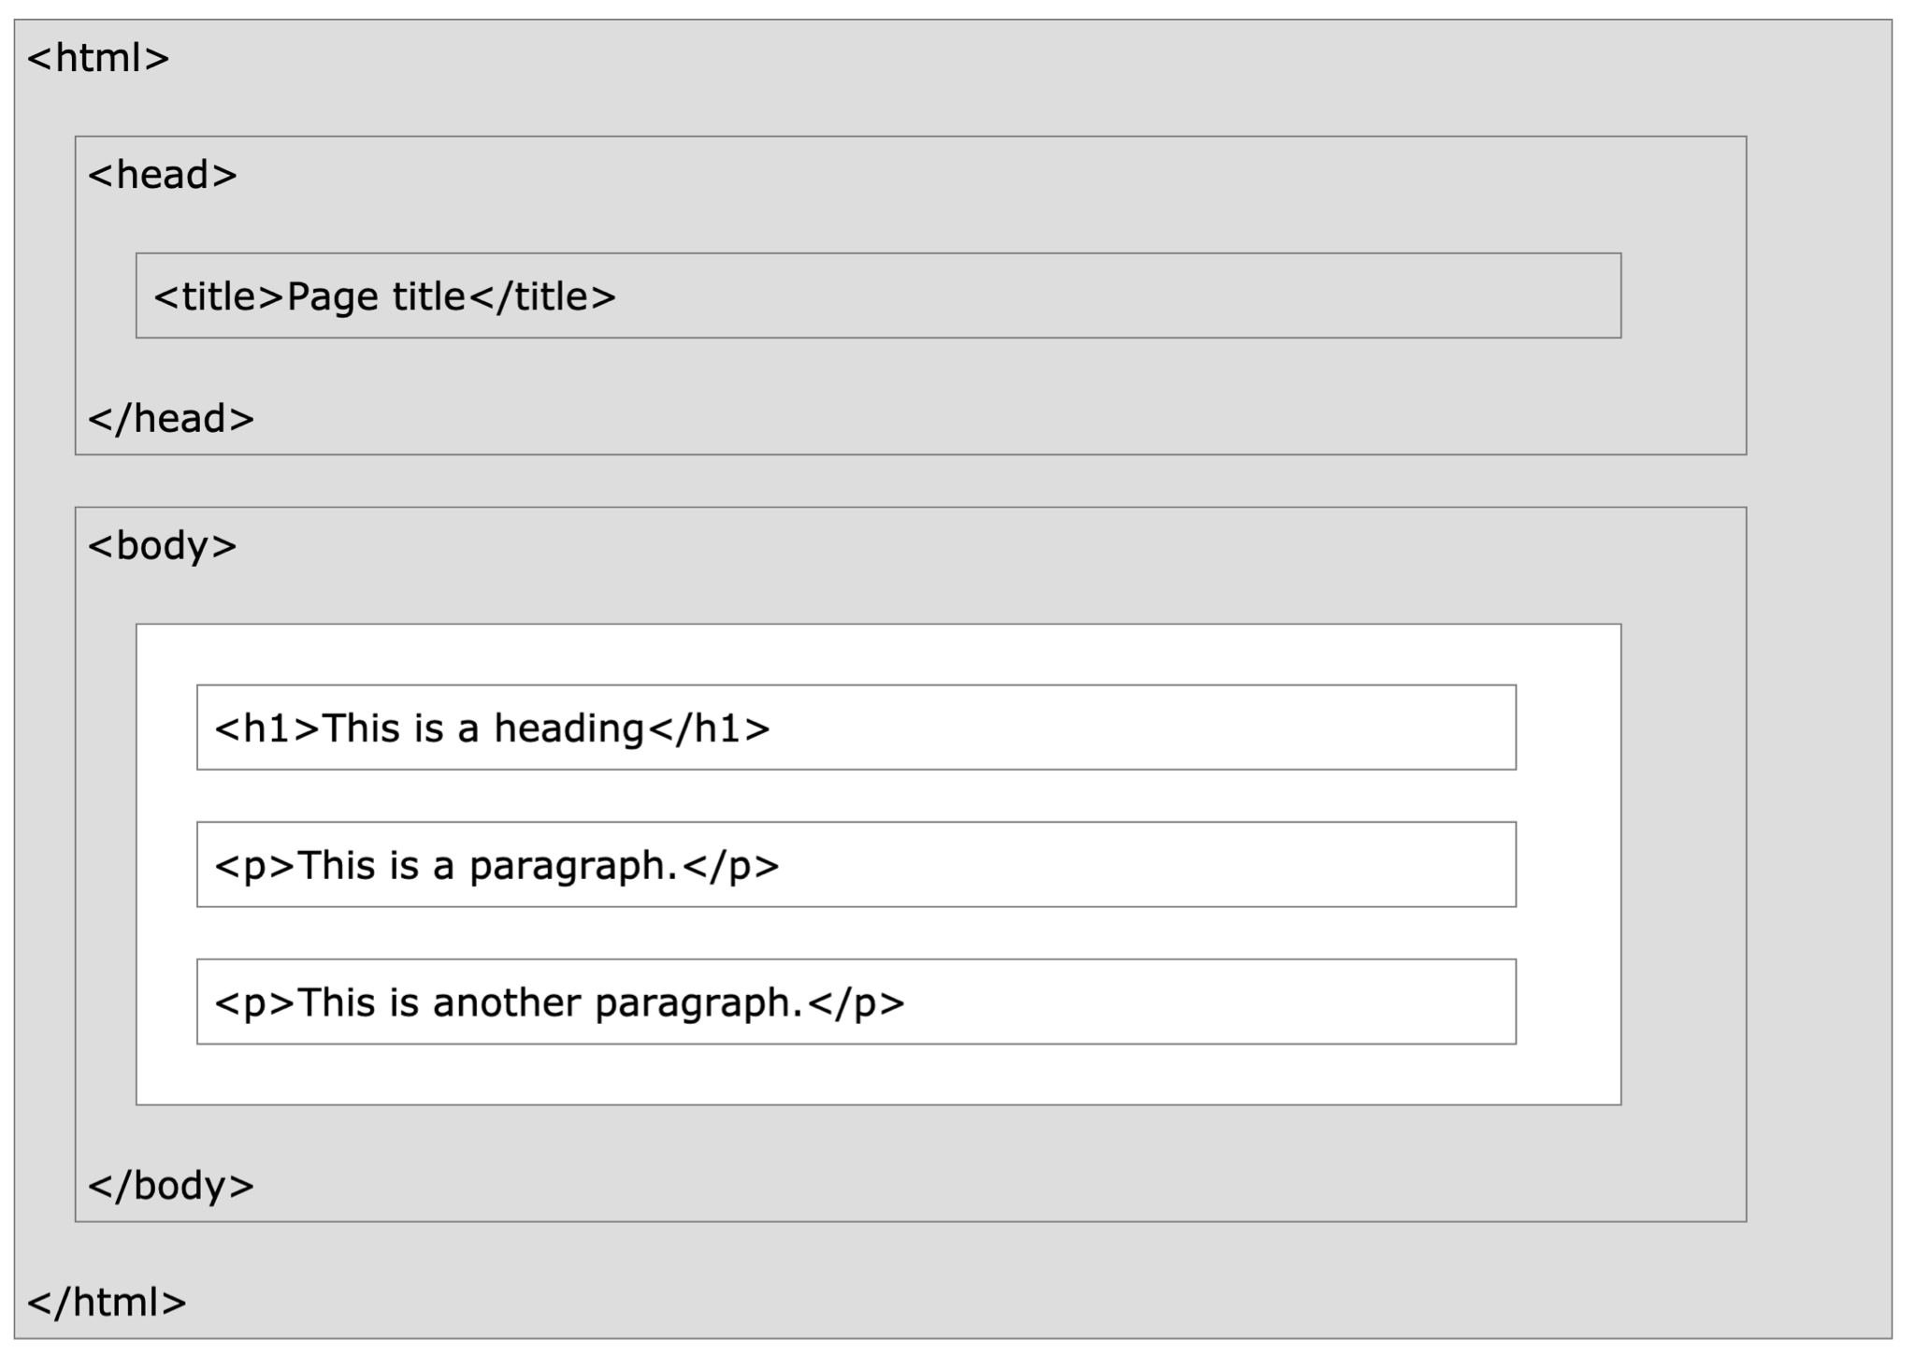
HTML STRUCTURE

Slide 12
HTML BASICS - SYNTAX
<p class="school">Dublin Coding</p>
<p Tag Opening
class="school" Class Name and Attribute
> - Tag Opening end
Dublin Coding Content, in this case text
</p> Closing Tag

Slide 13
HTML BASICS - SYNTAX
<!DOCTYPE html>
<html>
<head>
<title>Page Title</title>
</head>
<body>
<h1>My First Heading</h1>
<p>My first paragraph.</p>
</body>
</html>
The <!DOCTYPE html> declaration defines that this document is an HTML5 document
The <html> element is the root element of an HTML page
The <head> element contains meta information about the HTML page
The <title> element specifies a title for the HTML page (which is shown in the browser's title bar or in the page's tab)
The <body> element defines the document's body, and is a container for all the visible contents, such as headings, paragraphs, images, hyperlinks, tables, lists, etc.
The <h1> element defines a large heading
The <p> element defines a paragraph

Slide 14
HTML BASICS - SYNTAX
<!DOCTYPE html>
<html>
<head>
<title>Learning HTML</title>
</head>
<body>
<h1>
Hello,
<em>What is your name?</em>
</h1>
<div>
<img src="logo.png" alt="Logo" />
<p>Start learningHTML.</p>
</div>
</body>
</html>
html
head
title
body
h1
div
text
em
img
p
text
text

Slide 15
HTML BASICS - TYPES OF TAGS
Block Level Elements
Block level elements take up as much space as possible by default. Each block level element will start a new line on the page, stacking down the page. In addition to stacking vertically, block level elements will also take up as much horizontal space as possible.
The p element is an example of a block level element. Each new paragraph tag will appear on its own line vertically. Paragraphs with longer content will stretch all the way to the edge of the page.
<p>, <ol>, <ul>, <dl>, All headings <h1>…<h6>, <article>, <section>, <div>
Inline Elements
Inline elements display in a line. They do not force the text after them to a new line.
An anchor (or link) is an example of an inline element. You can put several links in a row, and they will display in a line.
<a>, <strong>, <em>, <b>, <i>, <q>, <mark>, <span>

Slide 16
HTML BASICS - TYPES OF TAGS
Meta Tags
Defines meta-data about the document
<meta name="viewport" content="width=device-width, initial-scale=1" />
<meta name="description“ content="Simple for Dublin Coding" />
Self Closing Tags
A self closing tag is a type of tag in HTML that need not to be closed by a closing tag, which means there is no separate closing tag for it as </tag>. For example <img /> tag, <input /> tag, <br /> tag, etc.
Comment Tags
Sometime you will need to add comments to your HTML code. These are pieces of text that are in the code but only visible when viewing the raw HTML and are never rendered
‹ ! -- This is a comment --›

Slide 17
BASIC HTML - TAGS
Tag | Description
<html> | Defines an HTML document
<head> | Contains metadata/information for the document
<title> | Defines a title for the document
<body> | Defines the document's body
<h1> to <h6> | Defines HTML headings
<p> | Defines a paragraph
<br/> | Inserts a single line break
<em> | Defines emphasized text typically italics
<strong> | Defines bold text
<input /> | Defines an input field
<a> | Defines a link
<ul> | Defines an unordered list
<li> | Defines a list item (usually contained in <ul> or <ol>)
<table> | Defines a Table
<div> | Defines a division or section in the document (Most commonly used tag)
<script> | Defines a script aka code like JavaScript
Reference: https://www.w3schools.com/tags/ref_byfunc.asp

Slide 18
HTML BASICS - ATTRIBUTES
<p id="school">Dublin Coding</p>
<img src="logo.png" alt="Logo" />
<input type="text" disabled />

Slide 19
HTML BASICS - SPECIFIC SYMBOLS
Result | Description | Entity Name | Entity Number
 | non-breaking space | &nbsp; | &#160;
< | less than | &lt; | &#60;
> | greater than | &gt; | &#62;
& | ampersand | &amp; | &#38;
" | double quotation mark | &quot; | &#34;
' | single quotation mark (apostrophe) | &apos; | &#39;
¢ | cent | &cent; | &#162;
£ | pound | &pound; | &#163;
¥ | yen | &yen; | &#165;
€ | euro | &euro; | &#8364;
© | copyright | &copy; | &#169;
® | registered trademark | &reg; | &#174;

Slide 20
CLASS WORK
Create a paragraph with text of your choice.
Add a "tooltip" to the paragraph with the text "This is a tooltip".
Style sone of the text using of any 3 tags of these tags - bold, italics, strikethrough, underline
Create two lists - ordered and unordered with items of your choice
Insert an image in the HTML page and add a alternative text message for image.
Use an anchor tag to open the image in new window.
Make use of any 3 special characters
Create a table with 3 columns and four rows
Use proper header for the columns

Slide 21
USEFUL RESOURCES
Validator - https://validator.w3.org/#validate_by_input
W3Schools - https://www.w3schools.com/html/
Tables - https://www.w3schools.com/html/html_tables.asp
Lists - https://www.w3schools.com/html/html_lists.asp

